Slide 1
FHIR: Why a New Approach to Healthcare Interoperability Standards?
Grahame Grieve
eHealth Interoperability Conference
12-Sept 2013

Slide 2
About Me
Pathology Scientist / Medical Research (90 – 97)
Kestral – Pathology and Radiology Systems Vendor (97 – 2010)
Product Development + Integration, Management
Involvement in HL7 (writing standards / consulting to national programmes)
Open Source Leadership (Eclipse OHF)
Health Intersections Pty Ltd (2011+)
Freelance consulting in Health care Interoperability & Product Development
Leading Development of FHIR

Slide 3
Overview
Introducing FHIR (Fast Healthcare Interoperable Resources)
Why HL7 needs a fresh approach
Leveraging web technologies in core healthcare business
How FHIR will drive down the costs of integration
Market consequence of changes in standards

Slide 4
HL7
“The 800lb Gorilla of Healthcare Standards”
Underlying standards for most interactions between healthcare systems
Messaging: HL7 v2
Clinical Documents: CDA
Basis for many Australian Standards + NEHTA/pcEHR

Slide 5
HL7 v2
Common Messaging standard in Australia
Simple syntax
East to Understand
Widely adopted
Much experience
Backwards comp. preserves investment
Old technology
Poor format
Very Limited Scope
Backwards comp. limits new ideas
Local agreement
If you’ve seen one v2 interface…

Slide 6
HL7 v3
Quality Methodology to supercede v2
Rigorous & Thorough Definitions
Computable Base
Massive Require-ments Exercise
Based on XML & UML
Deep Knowledge Required
Complex Syntax
Common Semantics != Common Engineering
If you’ve seen one v3 interface….
Very expensive

Slide 7
CDA
Clinical document (Narrative + v3 data)
Easier than v3
Reusable Engineering
Flexible and Adaptable
Widely adopted
Suits poor governance context
Documents are not data
Narrative vs Data
Hacking v2 & CDA together
Development still too complex
CDA is too simple for desires

Slide 8
OMG Collaboration
Common services for healthcare
Definitions – HL7 knowledge
Engineering – OMG expertise
Architectural relevance to big enterprise
Hybrid – Odd engineering
Uptake Variable
Mostly relevant to big enterprise

Slide 9
HL7 Position
Existing standards work tolerably well
Approach is fractured
None of the available approaches future proof
Mobile Application Client/Server
Web / Social Network / Cloud Integration
Vendor standards based API
Governments implementing national EHRs
HL7’s community – very unhappy

Slide 10
Fresh Look Taskforce
Charter: to examine the best ways it could create interoperability solutions, with no pre-conditions on what those solutions might be
Outcomes:
CIMI – Clinical Information Modeling Initiative
FHIR

Slide 11
Web Centric
A Fresh Look must start with the web
Successful integration not dreamed of even a decade ago
Leverage both technology and approaches
Get on board with “SMAC”

Slide 12
RESTful
Searching for success markers lead to RESTful APIs
In particular, 37Signals “Highrise” Application
Highly regarded “RESTful” API
Rewrote the Highrise API for healthcare
With as little change as possible
Very positively received

Slide 13
FHIR – http://hl7.org/fhir
Fast Health Interoperable Resources® (pr. “fire”)
Small building blocks for health records
XML / JSON representation
Tailored for REST but useable in other ways
Standard Data, Narrative, and Extensions
Best ideas from HL7, DICOM, IHE etc
Based on industry best practices, with a focus on simplicity and implementability
Administration / Clinical / Infrastructure

Slide 14
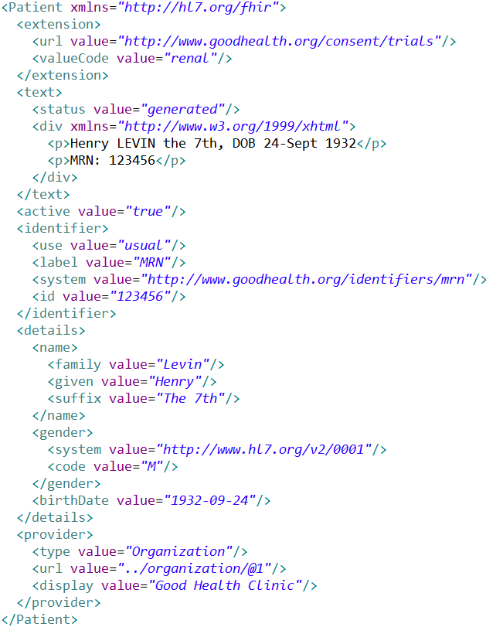
Extension with reference to its definition
Human Readable
Summary
Standard Data Content:
MRN
Name
Gender
Date of Birth
Provider

Slide 15
FHIR Development Progress
July 2011 – Conception
Aug/Sept 2012 – First Draft Ballot
Sept 2012 – First Connectathon
Aug/Sept 2013 (now) – First DSTU ballot DSTU = Draft Standard For Trial Use
Early 2014 – DSTU finalised
~2016 – Final full version

Slide 16
FHIR & Cost of Integration
FHIR is designed for implementers
Written to be understood and implemented
Resources are described in the language of the problem
Quality and Consistency is in the background
Version Stability inherent
100s of examples
Implementation assistance (code etc)
Live Servers, Regular Connectathons

Slide 17
FHIR & Cost of Integration
FHIR re-uses technology
Copy Facebook, Google, Twitter etc
Work with W3C
Skills & Libraries are easily available
RESTful API is re-usable
Push / Pull / Subscribe / Search
Build on top of it

Slide 18
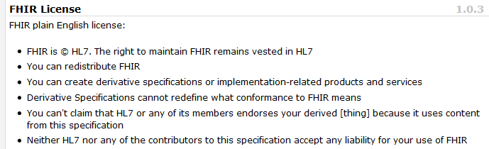
FHIR & Cost of Integration
FHIR is free and accessible
No limitations on use or distribution
Published as a website (direct linking)
Tutorials, Documentation published under open licenses

Slide 19
FHIR & Cost of Integration
These factors will drive down the cost of integration and interoperability
Easier to Develop
Easier to Troubleshoot
Easier to Leverage in production
More people to do the work (less expensive consultants)
Competing approaches will have to match the cost, or disappear – effect is already being felt

Slide 20
FHIR & Market Consequences
FHIR is a brand new approach
Is it really worth doing something brand new?
Initial response from HL7 community members is always negative
Drive to adopt FHIR comes from outside
Reason why FHIR is free
Classic change process problem

Slide 21
FHIR Community of Interest
July 2011 – A few insiders
Sept 2012 – The wider HL7 community
Early 2013 – National programs start exploring use of FHIR
Sept 2013 – The integration community (interface engine vendors) + (new) EHR vendors
2014/2015: Slow penetration across the market – especially large projects

Slide 22
FHIR & PHR
PHR market growing rapidly
Many PHR providers, 1000s of healthcare providers
Total cost for PHR connection - ~$100000
The PHR interface has to be commoditised
FHIR is the only candidate
Strong & Quick Adoption in this space

Slide 23
FHIR & PCEHR
PCEHR towards the end of it’s initial implementation
FHIR lifecycle too late by several years for PCEHR
For future PCEHR functionality, FHIR may be relevant
Project team watching FHIR (by implementing)

Slide 24


FHIR
Specification: http://hl7.org/fhir
Twitter: #FHIR (news feed)
Australian Connectathon: Sydney Oct 28/29 (http://ihic2013.org.au/)
My blog: http://www.healthintersections.com.au
© Health Intersections. This work is licensed under a Creative Commons Attribution 3.0 Unported License

